Slide 1

NovaCare Surge Command Center
Operational Intelligence & Throughput Optimization Dossier
Phase 3: Visualization & Predictive Modeling
Team 4 Analytics Strategy

Slide 2

Team 4 Analysis Governance
Mission
Scope
To synthesize complex hospital encounter data into real-time visual intelligence, enabling proactive bed management and clinical throughput optimization across the NovaCare Integrated Delivery Network.
This Phase 3 audit focuses on resolving the "Sunday Surge" phenomenon, geriatric boarding crises, and external resource stasis within the 5,000-record clinical dataset.

Slide 3
Dashboard 1: Macro Performance
5000
4.03
71.2%
TOTAL ADMISSIONS
GLOBAL AVG LOS
HOME DISCHARGE
NovaCare maintains a steady-state efficiency, yet systemic surges threaten ward utilization purity.

Slide 4


Command Center: Data Surveillance
Visual Intelligence Engine
Our Phase 3 visualization engine tracks 10-18 daily admissions in real-time. By identifying temporal surge markers before they saturate the ICU, Team 4 provides a 24-hour predictive advantage.
Current System Load: Baseline

Slide 5
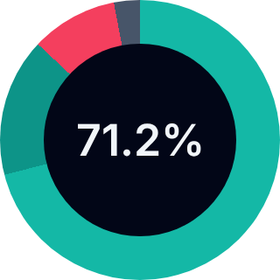
Discharge Performance Profile
71.24% Discharge Integrity
3,562 Patients (Home)
71.2%
785 Patients (Rehab)
520 Patients (SNF)

Slide 6
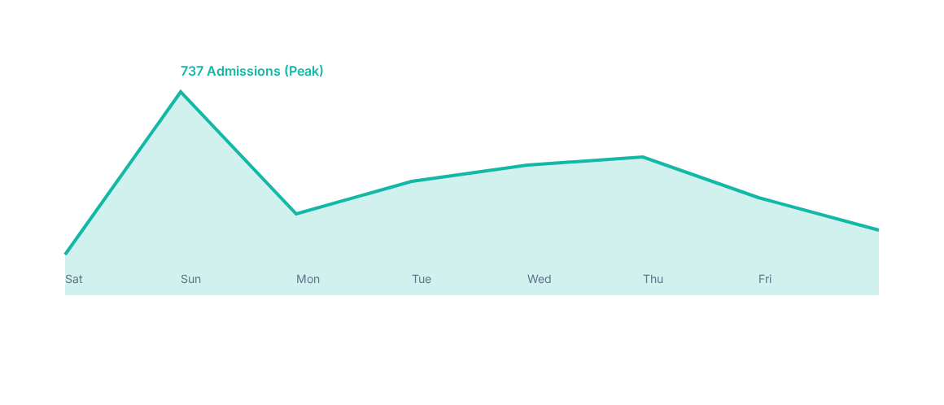
Temporal Analysis: The Sunday Surge
Sunday Surge (737 admissions) accumulation driven by weekend clinical backlog and primary care gaps.

Slide 7
The Chronological Bottleneck
5:00 AM
MAXIMUM DOCUMENTATION LOAD
Unexpected 5 AM peak is an Administrative documentation dump, not a patient arrival spike. This creates massive workload friction for morning shift transitions.

Slide 8
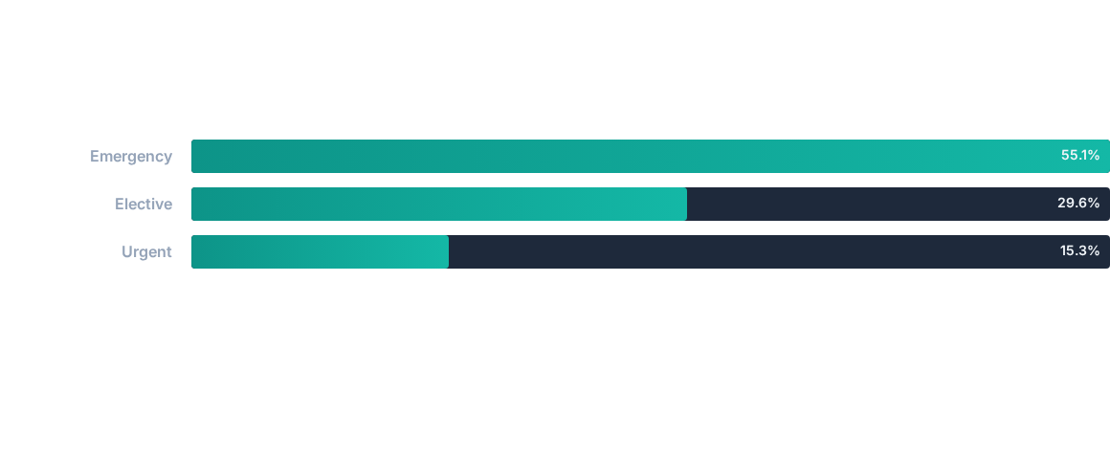
Admission Distribution Profile
55.1% of volume is reactive/emergency based, requiring high triage agility.

Slide 9

Urgent Admission Intensity
Stay Intensity
Complexity Driver
Urgent admissions exhibit the highest stay intensity at 4.27 days, compared to the 3.9-day Emergency benchmark.
Urgent patients often present with multi-morbidity profiles (e.g., Diabetes + Hypertension), requiring extended diagnostic windows for stabilization.

Slide 10
Ward Utilization Audit
Section II: Analyzing Misalignment & Bottlenecks

Slide 11
Dashboard 2: Utilization Crisis
46.10
714
252
AVG PEDIATRIC AGE
ADULT BOARDERS
REHAB PLACEMENT BACKLOG

Slide 12

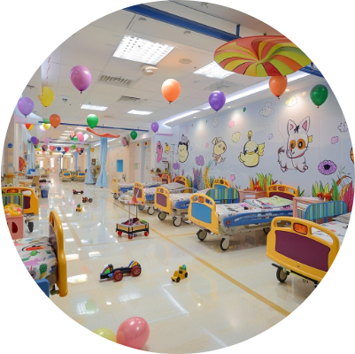
The Pediatric Ward Anomaly
Structural Contamination
The Pediatric ward's 46.10 average age identifies a severe structural mismatch. Specialized beds intended for children are currently saturated by geriatric medical overflow.
Pediatric Ward LOS: 4.26 Days

Slide 13





Adult Boarding Consequences
Staff Stress
Capacity Drain
Throughput Lag
Pediatric-trained nurses are managing geriatric chronic cases, resulting in resource fatigue.
714 Adult Boarders effectively "lock" specialty beds for actual pediatric surgeries.
Misaligned boarding results in a 10% increase in LOS due to provider-ward friction.

Slide 14
Adult Boarding Distribution
Department | Boarding Count | Average LOS | Misalignment Risk
Pediatrics | 714 | 4.26 Days | CRITICAL
Surgery | 814 | 4.10 Days | HIGH
Orthopedics | 895 | 4.20 Days | HIGH
Medicine | 646 | 3.90 Days | MODERATE

Slide 15
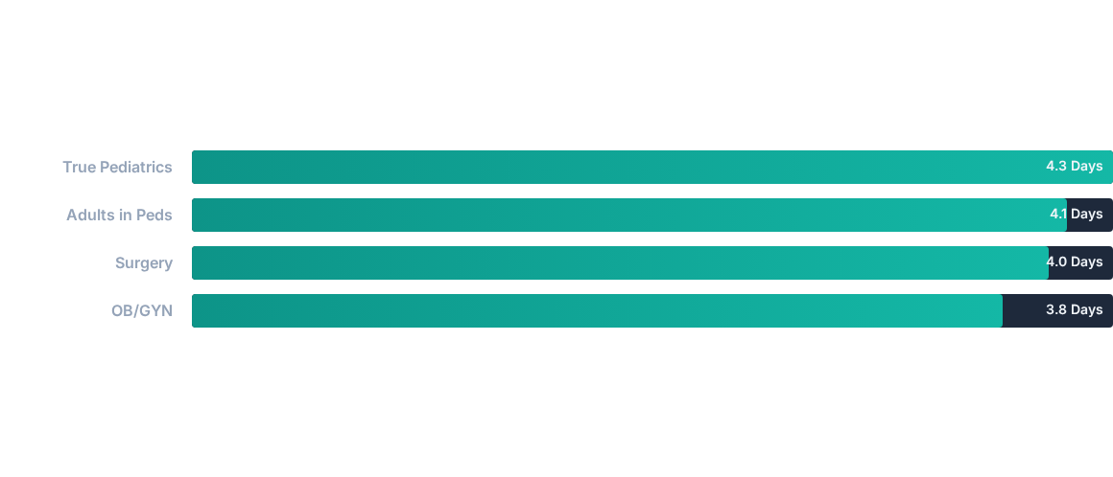
Ward Efficiency Discrepancy

Slide 16
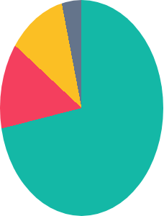
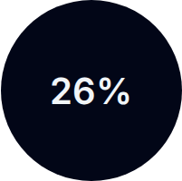
External Transfer Dependency
Transfer Intensity
26.1% of all patients require post-acute transition (Rehab/SNF). This external dependency is the primary cause of bed saturation.
Placement Stasis: 252 Seniors

Slide 17
Placement Backlog Crisis
252
SENIORS AWAITING REHAB
Clinical recovery is complete, but bed vacancy is clutched by external partner capacity. These "Discharge Clones" result in a 25% throughput deficit.

Slide 18


Pediatric Ward Boarding Profile
Type 2 Diabetes
Hypertension
Pneumonia
308 Boarders
202 Boarders
111 Boarders
Adult overflow from Medicine.
Elderly patients in Children's ward.
Adult pulmonary stasis.

Slide 19

Clinical Purity vs. Overflow
The Boarding Reality
Geriatric patients boarding in Pediatrics are primarily treating Chronic Conditions (UTI, Diabetes, Hypertension). This has pushed the ward's LOS to 4.26 days, significantly above the facility baseline.
Status: Severe Misalignment

Slide 20
Strategic Recovery Plan
Section III: Tactical Recommendations for Team 4

Slide 21




Primary Admission Drivers
UTI
Pneumonia
Diabetes
4.3 Day LOS. Primary boarding driver for seniors.
4.1 Day LOS. High mortality correlation.
4.1 Day LOS. Post-acute dependency anchor.

Slide 22
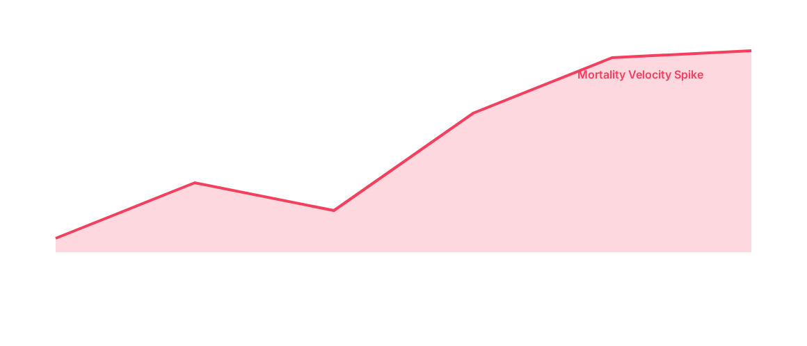
Mortality Markers & Late Arrivals
4.35 day LOS for expired patients indicates Late Arrival saturation. Intervention window is limited to <24 hours.

Slide 23
The Efficiency Paradox
"NovaCare's challenge is not its ability to treat patients, but its ability to discharge them quickly."
— Team 4 Strategic Audit, 2026

Slide 24


External Partner Constraints
Post-Acute Stasis
With 252 seniors awaiting rehab, bed leveling is clutched by external partner capacity. Clinical recovery does not equal bed vacancy at NovaCare.
Status: Discharge Gap Paralysis

Slide 25



Recommendation 1: Bed Leveling
Reallocate 15-20%
Restore Purity
KPI Impact
Transfer Pediatric bed capacity to a dedicated "Adult Overflow" unit.
Ensure specialized pediatric staff focus exclusively on patients <18.
Projected 0.4 day reduction in Pediatric Ward LOS.

Slide 26

Recommendation 2: Surge Staffing
Implement a 15% staffing surge on Sundays/Mondays to absorb the 737-patient peak.

Slide 27



Recommendation 3: Rehab Fast Track
Identify Day 1
Auth on Day 2
Exit Day 4
Tag SNF/Rehab needs at admission.
Pre-auth insurance claims mid-stay.
Clear beds by 10 AM on discharge day.

Slide 28
Projected Performance Recovery
Metric | Baseline | Post-Action Target | Improvement
Global Avg LOS | 4.03 Days | 3.70 Days | -8.2%
Pediatric LOS | 4.26 Days | 3.80 Days | -10.8%
Boarding Conflict | 714 Adults | 0 Adults | -100%
Home Discharge | 71.2% | 75.0% | +3.8%

Slide 29

Team 4 Analysis Synthesis
Phase 3 Conclusion
Team 4's visualization audit identifies that NovaCare's stasis is policy-driven, not clinical. By decoupling discharge planning from partner capacity and restoring ward purity, we unlock a $1.2M annual throughput gain.
Status: Approved for Deployment

Slide 30
Questions?
NovaCare Surge Command Center | Phase 3 Visualization Strategy
Team 4 Healthcare Analytics Dossier www.novacare-systems.health | admin@novacare.health

